Slide 1
I love Writing
February 3th, 2021

Slide 2
Some comments about how to make me useful to my classmates through the writing...

Slide 3
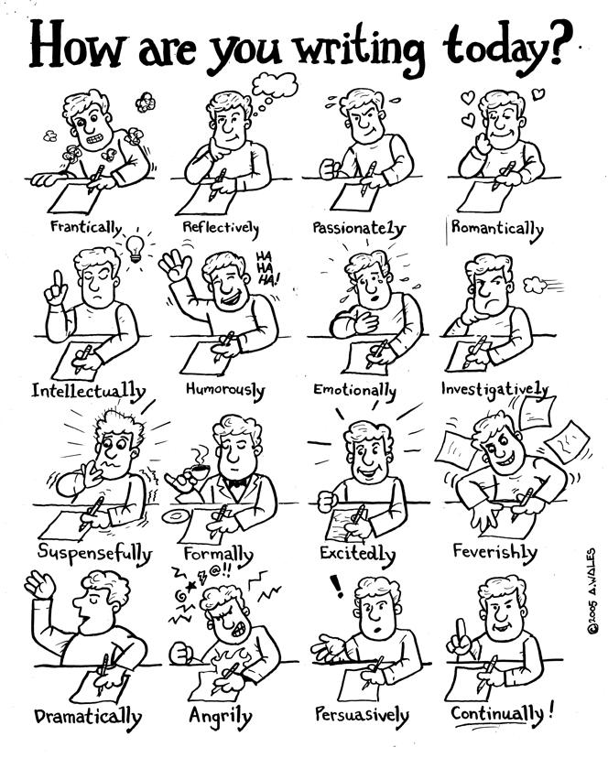

Slide 4
See you dude <3

